Slide 1

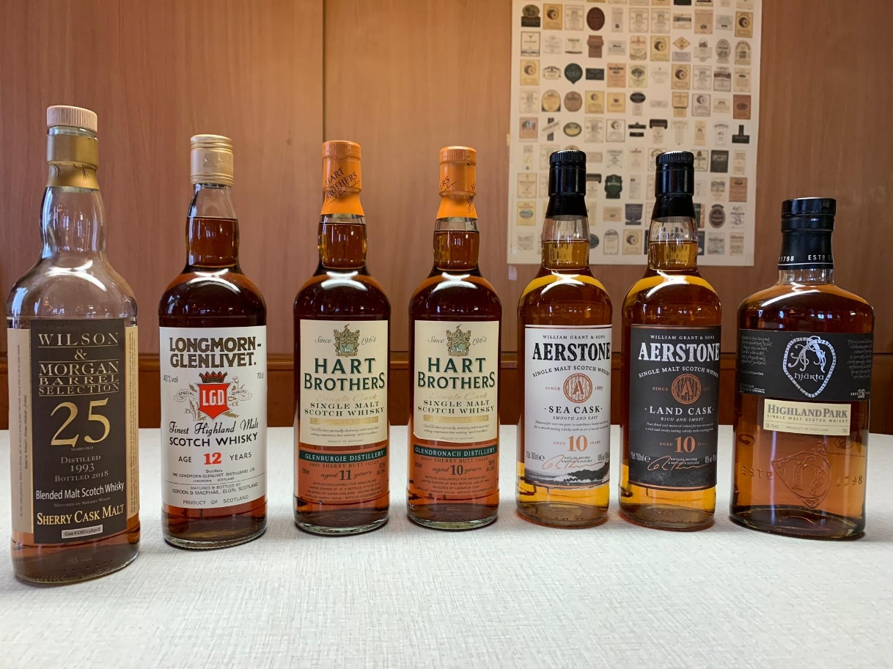
SEVENTEEN DRAMS
ONLINE TASTING 7. Juli 2020

Slide 2
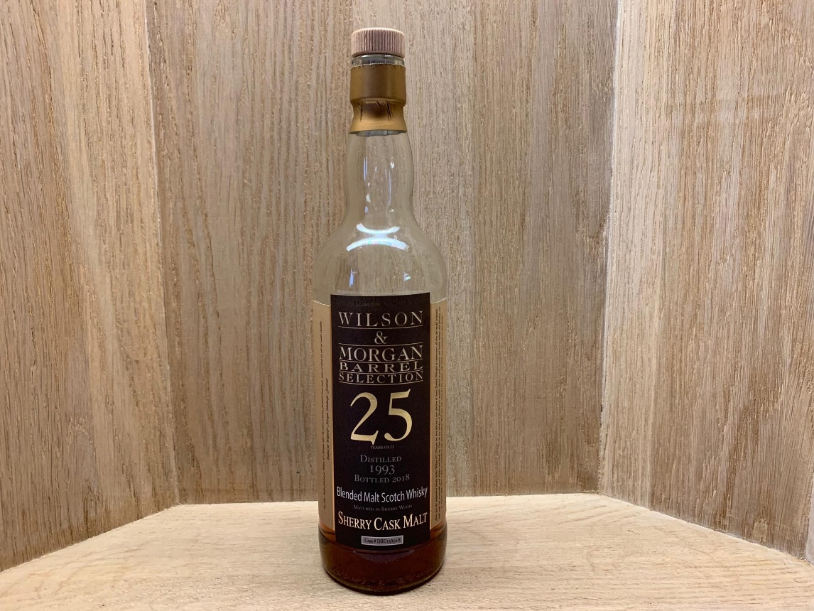
SEVENTEEN DRAMS
Wilson & morgan barrel selection 25Yo 1993/2018 sherry cask 53.5%

Slide 3
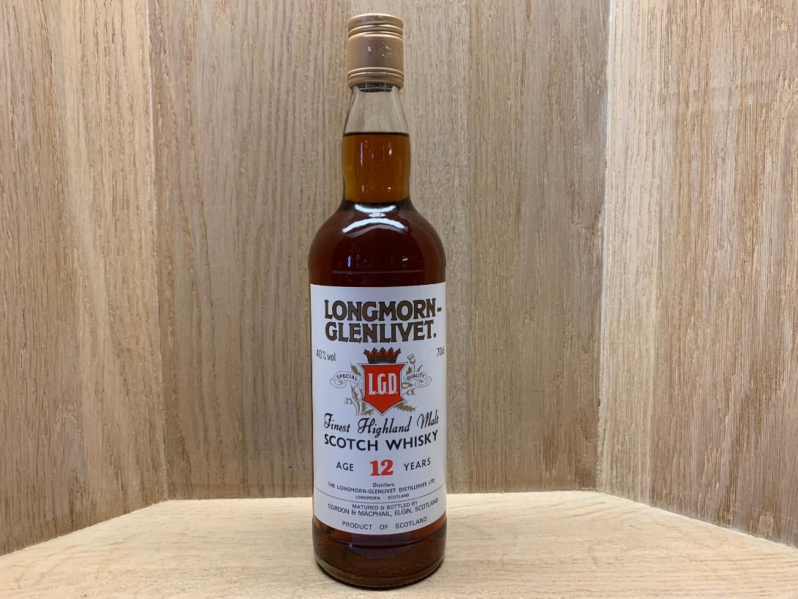
SEVENTEEN DRAMS
Gordon & macphails
Longmorn-glenlivet 12y0 40%

Slide 4
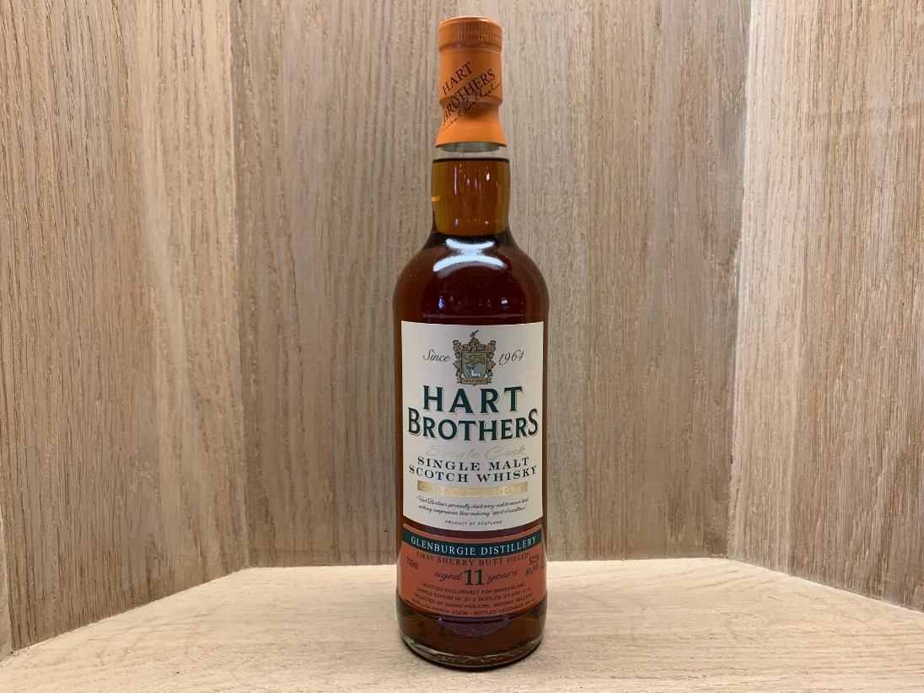
SEVENTEEN DRAMS
Hart brothers for langatun
Glenburgie 11yo 2008/2019 57.5%

Slide 5
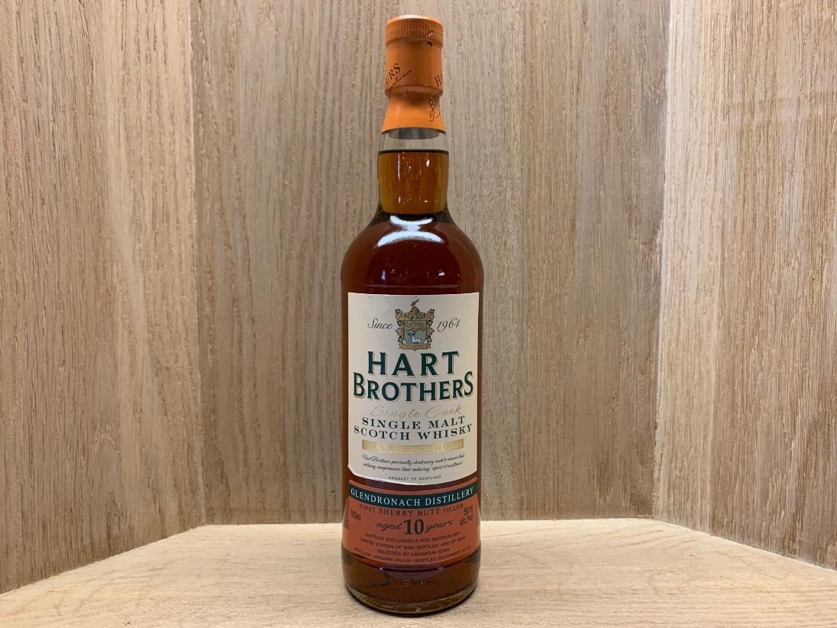
SEVENTEEN DRAMS
Hart brothers for langatun
Glendronach 10yo 2009/2019 58.1%

Slide 6
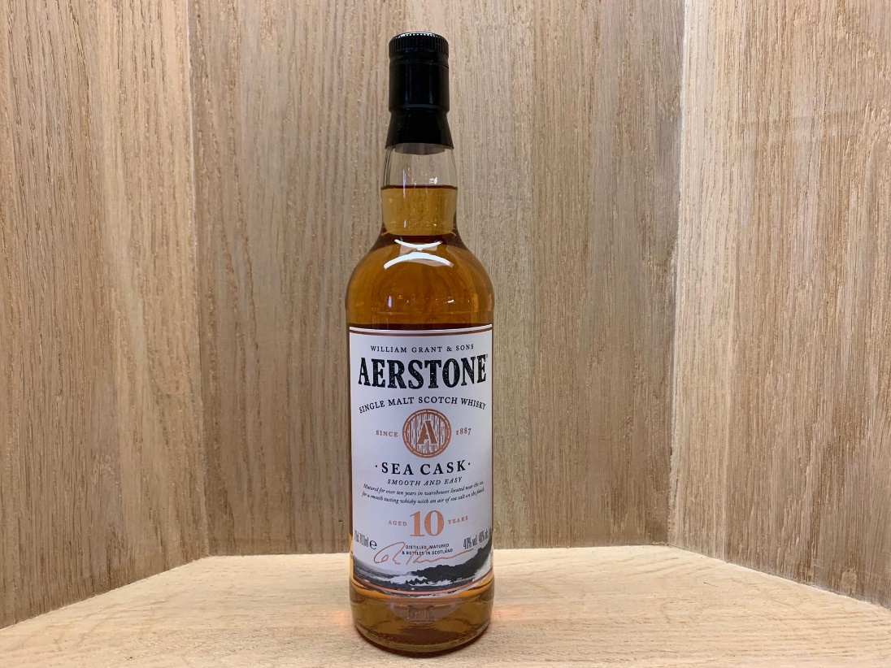
SEVENTEEN DRAMS
Aerstone 10yo
sea cask 40%

Slide 7
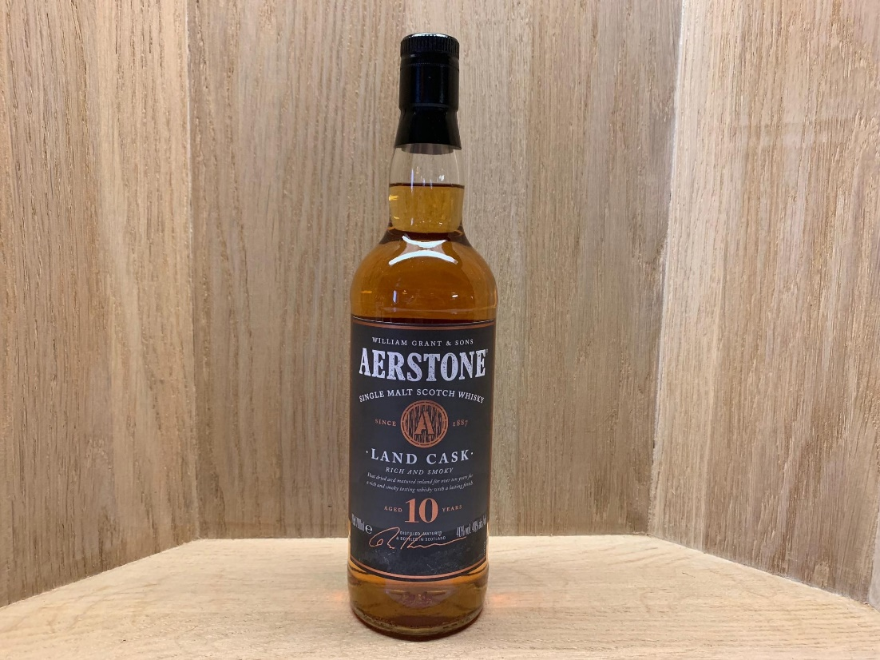
SEVENTEEN DRAMS
Aerstone 10yo
Land cask 40%

Slide 8
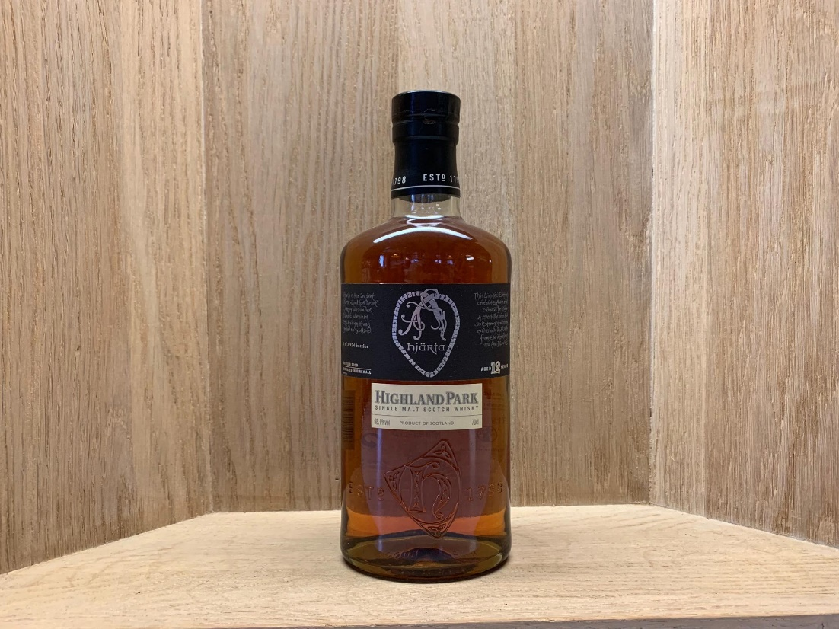
SEVENTEEN DRAMS
Highland park 12yo bottled 2008
hjärta 1 of 3’924 bottles 58.1%

